Slide 1
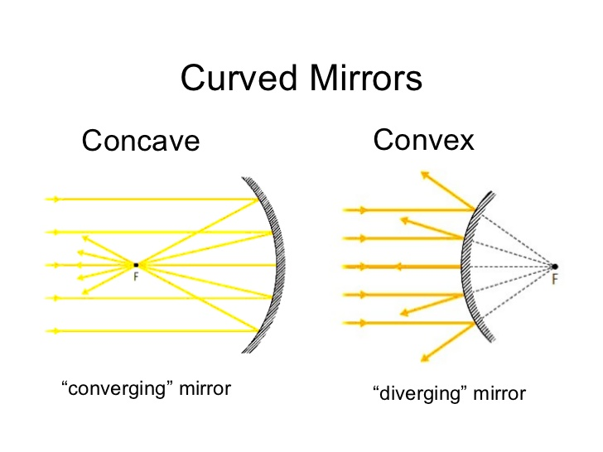
Daily Review
Curved Mirrors
There are two types of curved mirrors: concave mirrors and convex mirrors.
Explain the difference between a concave mirror and a convex mirror.

Slide 2
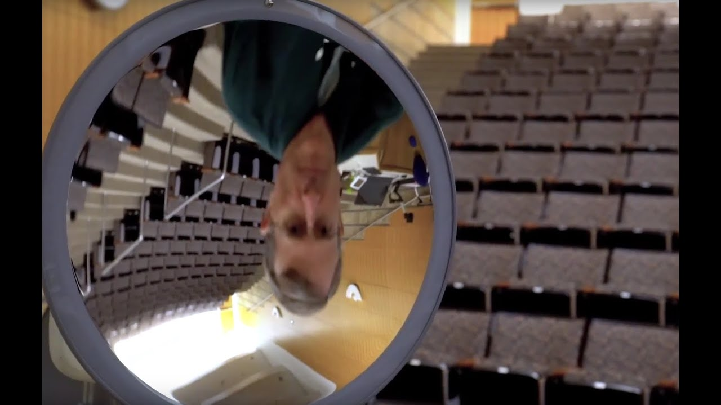
Daily Review
Reminder:
Bigger = magnified Smaller = diminished Right way up = upright Upside down = inverted
Images in Curved Mirrors
Describe the image formed using the terms below. Use the image type to identify type of mirror: Convex = diminished and upright Concave (close) = enlarged and upright Concave (far away) = diminished and inverted
Describe the image in the mirror and identify the type of mirror.

Slide 3
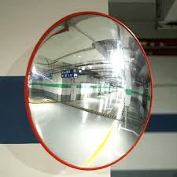
Daily Review
Reminder:
Bigger = magnified Smaller = diminished Right way up = upright Upside down = inverted
Images in Curved Mirrors
Describe the image formed using the terms below. Use the image type to identify type of mirror: Convex = diminished and upright Concave (close) = enlarged and upright Concave (far away) = diminished and inverted
Describe the image in the mirror and identify the type of mirror.

Slide 4
Refraction Year 9 Physics

Slide 5
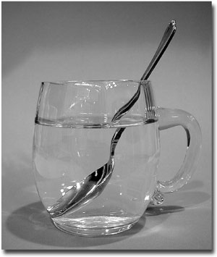
Learning Objectives
CFU
What are we going to learn?
Define and explain refraction.
Describe how light is refracted in different situations.
Activate Prior Knowledge
When you look at an object through water, it often appears distorted or bent, like the spoon in the image to the right.
Describe another example where water distorts the shape or appearance of an object.

Slide 6
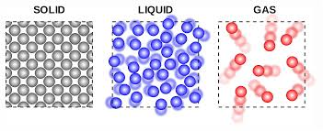
Concept Development
CFU 1
Which is more dense, a solid or a gas? Explain your choice.
Speed of Light
The speed of light the vacuum of space is approximately 300,000,000 m/s.
When light passes through a denser material, such as air or water, it slows down.
The denser the material, the slower light travels.
CFU 2
What happens to the speed of light when it travels through a dense material?
Vocabulary
Density: mass per unit of volume.

Slide 7
Concept Development
CFU 1
What is refraction and what happens when light is refracted?
Refraction
Refraction is the bending of light as it travels at an angle from one transparent material into another.
Often when light is refracted, our view of objects is distorted.
The density of the material determines how much the light bends.
A more dense material slows down and bends light more than a less dense material.
CFU 2
What does the amount of bending depend on?

Slide 8
Concept Development
CFU 1
What is the refractive index comparing?
Refractive Index
The refractive index compares the speed of light in a material to its speed in a vacuum.
The slower light travels in a medium, the higher its refractive index and the more the light is bent.
The refractive indices of some substances are shown below.
CFU 2
What is the relationship between refractive index and the speed of light?
CFU 3
In the list given, which of the substances does light travel the slowest? Explain your choice.
Substance | Refractive Index
Air | 1.00
Water | 1.33
Perspex | 1.49
Glass | 1.53
Diamond | 2.42

Slide 9
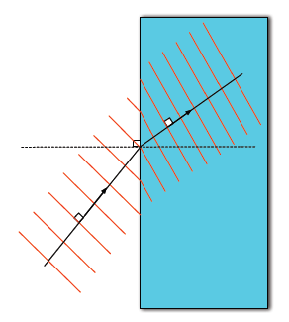
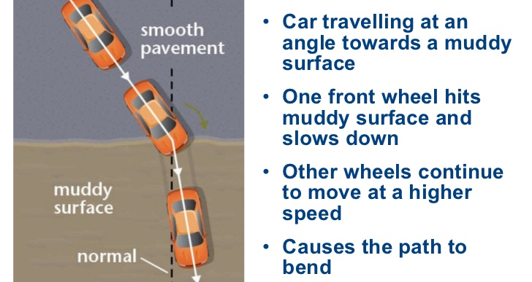
Concept Development
CFU 1
Why do light rays refract?
Cause of Refraction
When light rays enter a different material on an angle, one side of the light ray changes speed before the other, causing the light to bend.
This is often compared to how a car slows down on muddy or sandy surfaces.

Slide 10
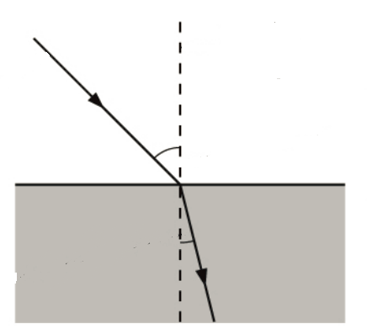
Concept Development
CFU 1
How is refraction similar to reflection?
Refraction
The normal is an imaginary line at right angles to the surface between the two substances.
The incoming light ray is the incident ray (i), and its angle with the normal is the angle of incidence (ϴ_{i}).
The bent light ray is called the refracted ray (r), and its angle with the normal is the angle of refraction (ϴ_{r}).
CFU 2
What is the refracted ray?
CFU 3
How is the angle of refraction measured?
N
i
ϴ_{i}
ϴ_{r}
r

Slide 11
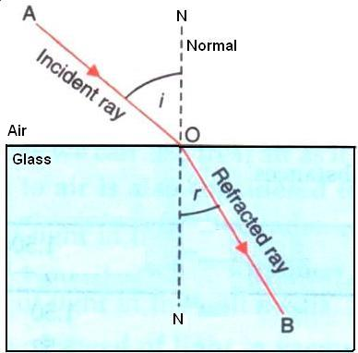
Concept Development
CFU 1
When does light bend towards the normal?
Refraction
When light rays enter a denser material (eg. air into glass), the light slows down and is bent towards the normal.
The angle of refraction is less than the angle of incidence.
CFU 2
How light would bend traveling from air into water? Justify your choice.

Slide 12
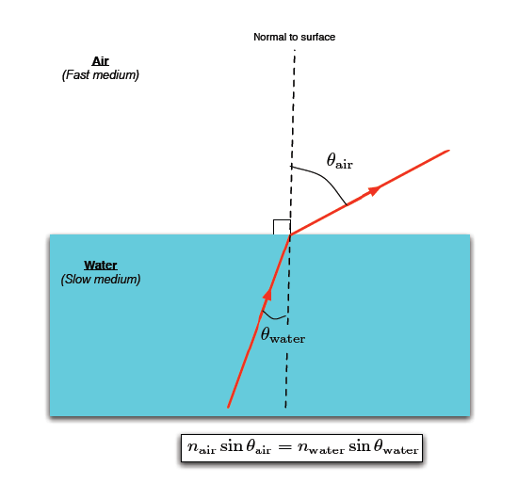
Concept Development
CFU 1
When does light bend away from the normal?
Refraction
When light rays move from a dense material to a less dense material, they speed up and bend away from the normal.
The angle of refraction is greater than the angle of incidence.
CFU 2
Redraw the diagram below and draw the path the light ray would take when it leaves the glass block back into air.
N
r
ϴ_{r}
ϴ_{i}
i

Slide 13
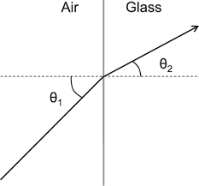
Skill Development/Guided Practice
CFU 2
Is the light going to slow down or speed up?
CFU 1
What are the refractive indices of air and glass?
Describing Refraction
Identify the refractive indices of the substances. State the change in refractive index: high to low / low to high Explain what happens to the speed of the light and which way it bends. Light slows down = bends towards normal Light speeds up = bends away form normal
Explain what happens to light as it passes from air into a glass block.
Substance | Refractive Index
Air | 1.00
Water | 1.33
Perspex | 1.49
Glass | 1.53
Diamond | 2.42
Light is passing from a medium with a low refractive index to one with a higher refractive index.
The light will slow down and bend towards the normal.

Slide 14
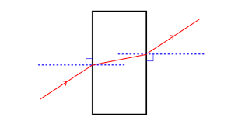
Skill Development/Guided Practice
CFU 2
Is the light going to slow down or speed up?
CFU 1
What are the refractive indices of air and glass?
Describing Refraction
Identify the refractive indices of the substances. State the change in refractive index: high to low / low to high Explain what happens to the speed of the light and which way it bends. Light slows down = bends towards normal Light speeds up = bends away form normal
Explain what happens to light as it passes from the glass block back into air.
Substance | Refractive Index
Air | 1.00
Water | 1.33
Perspex | 1.49
Glass | 1.53
Diamond | 2.42
Light is passing from a medium with a high refractive index to one with a lower refractive index.
The light will speed up and bend away from the normal.

Slide 15
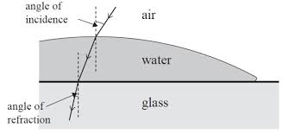
Skill Development/Guided Practice
CFU 2
Is the light going to slow down or speed up?
CFU 1
What are the refractive indices of air and glass?
Describing Refraction
Identify the refractive indices of the substances. State the change in refractive index: high to low / low to high Explain what happens to the speed of the light and which way it bends. Light slows down = bends towards normal Light speeds up = bends away form normal
Explain what happens to light as it passes through water into a glass object.
Substance | Refractive Index
Air | 1.00
Water | 1.33
Perspex | 1.49
Glass | 1.53
Diamond | 2.42
Light is passing from a medium with a _____ refractive index to one with a _____ refractive index.
The light will _____ and bend _____ from the normal.

Slide 16
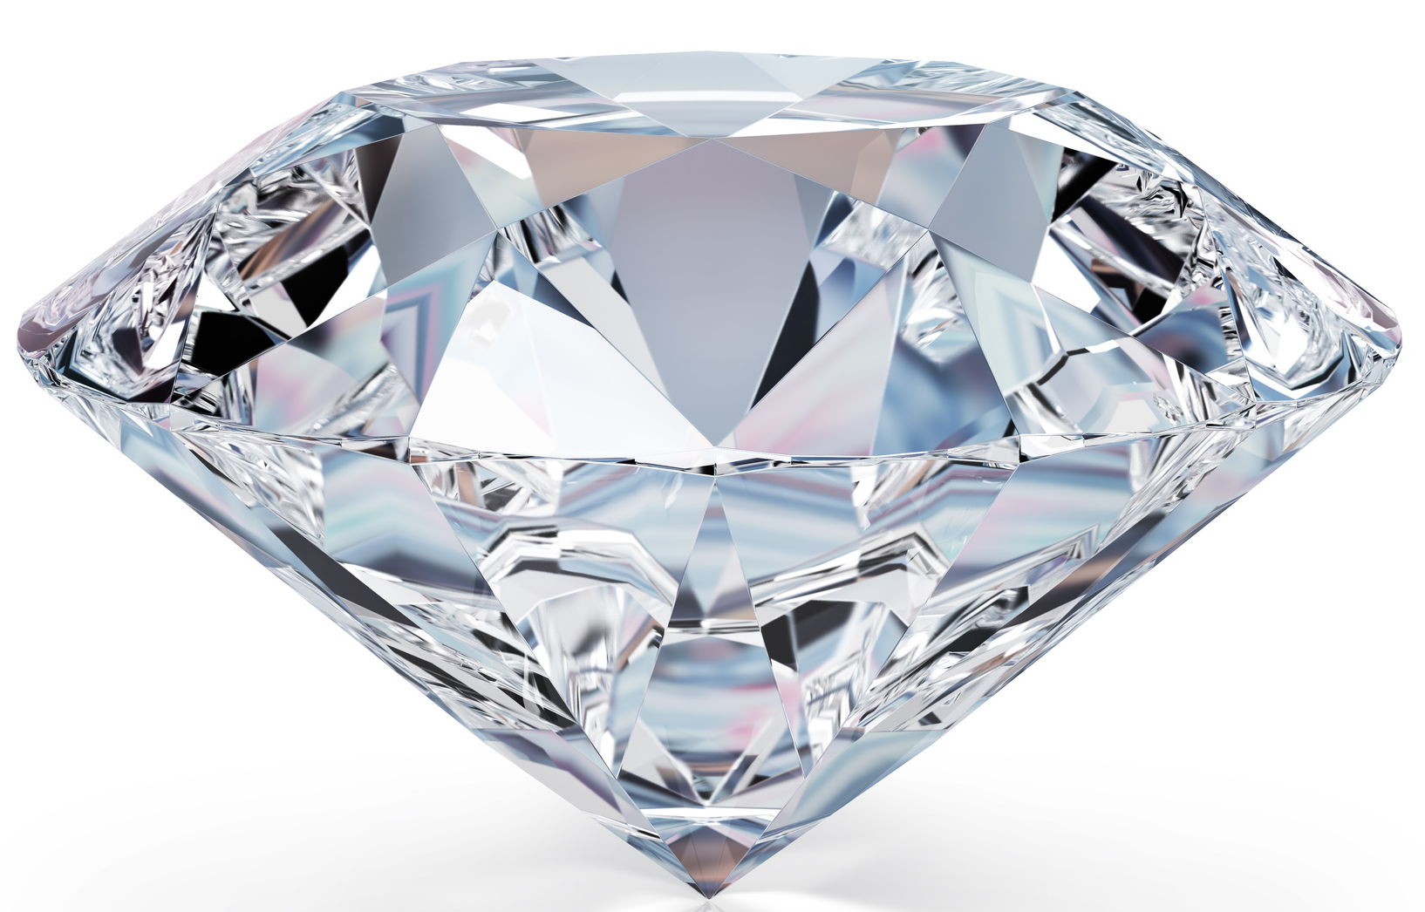
Skill Development/Guided Practice
CFU 2
Is the light going to slow down or speed up?
CFU 1
What are the refractive indices of air and glass?
Describing Refraction
Identify the refractive indices of the substances. State the change in refractive index: high to low / low to high Explain what happens to the speed of the light and which way it bends. Light slows down = bends towards normal Light speeds up = bends away form normal
Explain what happens to light as it passes from a diamond back into air.
Substance | Refractive Index
Air | 1.00
Water | 1.33
Perspex | 1.49
Glass | 1.53
Diamond | 2.42
Light is passing from a medium with a _____ refractive index to one with a _____ refractive index.
The light will _____ and bend _____ from the normal.

Slide 17
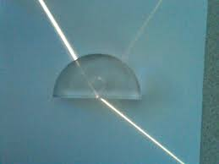
Skill Development/Guided Practice
CFU 2
Is the light going to slow down or speed up?
CFU 1
What are the refractive indices of air and glass?
Describing Refraction
Identify the refractive indices of the substances. State the change in refractive index: high to low / low to high Explain what happens to the speed of the light and which way it bends. Light slows down = bends towards normal Light speeds up = bends away form normal
Explain what happens to light as it passes from air into a Perspex block.
Substance | Refractive Index
Air | 1.00
Water | 1.33
Perspex | 1.49
Glass | 1.53
Diamond | 2.42
Light is passing from a medium with a _____ refractive index to one with a _____ refractive index.
The light will _____ and bend _____ from the normal.

Slide 18
Relevance
Knowing about how the speed of light changes in different materials will help you understand how light is bent, or refracts, when it passes through different substances.
Understanding how light refracts will help you explain how depth illusions occur.
Refraction is also used in lenses for glasses to focus light, which helps peoples’ vision.

Slide 19
Skill Closure
Explain what happens to the speed of light as it travels through a dense material, compared to a less dense material.
Substance | Refractive Index
Air | 1.00
Water | 1.33
Perspex | 1.49
Glass | 1.53
Diamond | 2.42
Skill Closure
Use the diagram to explain why light refracts when it passes on an angle from one material into another?
Skill Closure
Explain what will happen to a light ray as it passes through glass into diamond.
Describing Refraction
Identify the refractive indices of the substances. State the change in refractive index: high to low / low to high Explain what happens to the speed of the light and which way it bends. Light slows down = bends towards normal Light speeds up = bends away form normal

Slide 20
Independent Practice
Complete the questions below on your device or in your book.
How does the speed of light change in materials of different densities?
What does the refractive index of a medium measure?
When light passes from a more dense medium into a less dense medium, which way does the light refract?
When light passes from a less dense medium into a more dense medium, which way does the light refract?
Complete questions 1 to 3 on page 83 of the text book.

